Slide 1
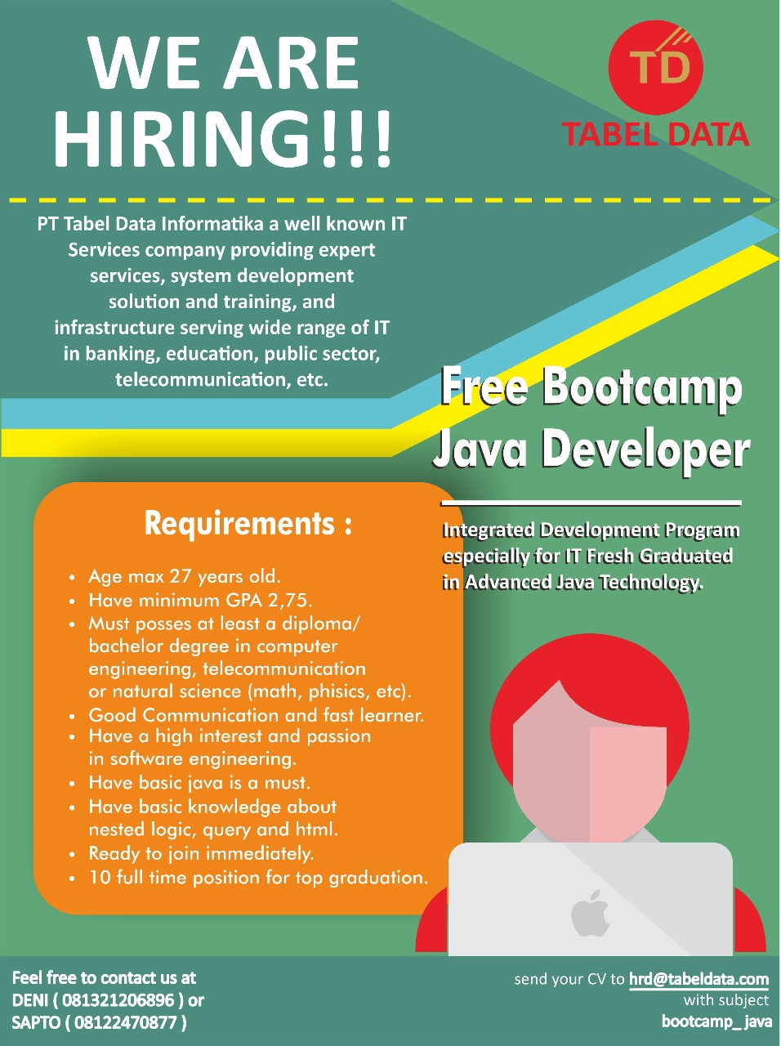
Bootcamp Java Developer #Day 1
PT. Tabel Data Infromatika
By Dimas Maryanto,S.Kom

Slide 2
Java Database Connectivity
JDBC is Java API that can access any kind of tabular data, especially data stored in a Relational Database.

Slide 3
Istilah dalam JDBC
Setup / Konfigurasi
Implementasi
Datasource
DriverManager
Driver
URL JDBC
User
Password
Connection
Statement
PreparedStatement
ResultSet
Transaction
Commit
Rollback

Slide 4
Setup Connection

Slide 5
Statement
A Statement is an interface that represents a SQL statement. You execute Statement objects, and they generate ResultSet objects, which is a table of data representing a database result set. You need a Connection object to create a Statement object.

Slide 6
ResultSet
You access the data in a ResultSet object through a cursor. Note that this cursor is not a database cursor. This cursor is a pointer that points to one row of data in the ResultSet object. Initially, the cursor is positioned before the first row. You call various methods defined in the ResultSet object to move the cursor.

Slide 7
Close Statemet
When you are finished using a Statement, call the method Statement.close to immediately release the resources it is using. When you call this method, its ResultSet objects are closed.

Slide 8
PreparedStatement
The main feature of a PreparedStatement object is that, unlike a Statement object, it is given a SQL statement when it is created. The advantage to this is that in most cases, this SQL statement is sent to the DBMS right away, where it is compiled. As a result, the PreparedStatement object contains not just a SQL statement, but a SQL statement that has been precompiled. This means that when the PreparedStatement is executed, the DBMS can just run the PreparedStatement SQL statement without having to compile it first.

Slide 9
SQL injection

Slide 10
Transactional
Commit
Rollback
Savepoint

